Slide 1
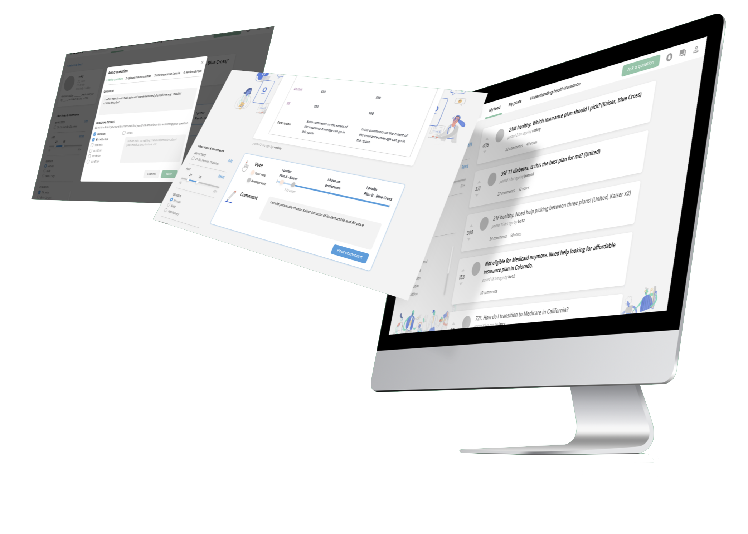
ask.in
Med-fi Prototype 3
Team Larry the Porcupine
Sean Chang, Grace Zhao, Melinda Wang,
Ari Qayumi & Vrinda Vasavada

Slide 2



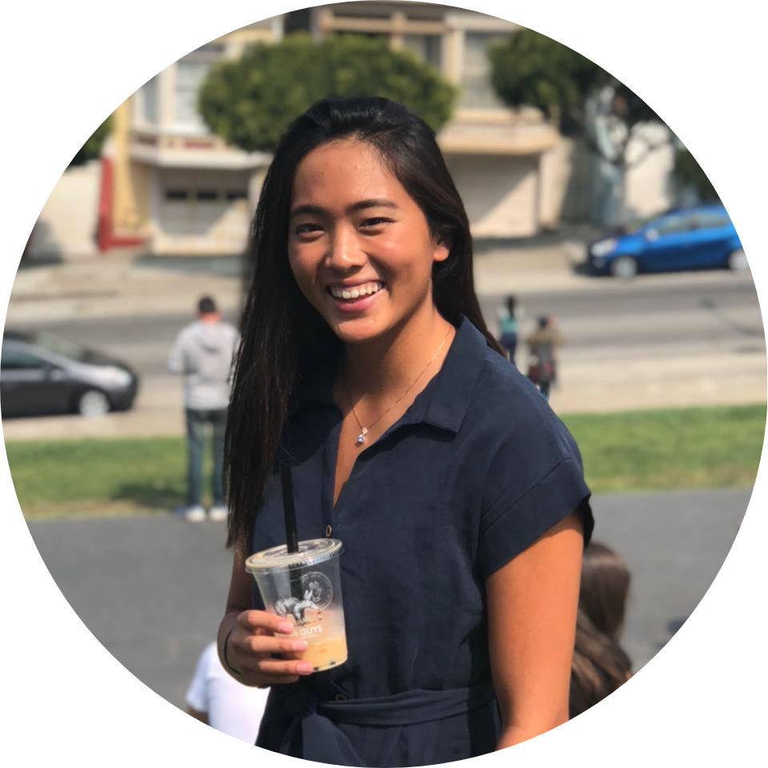
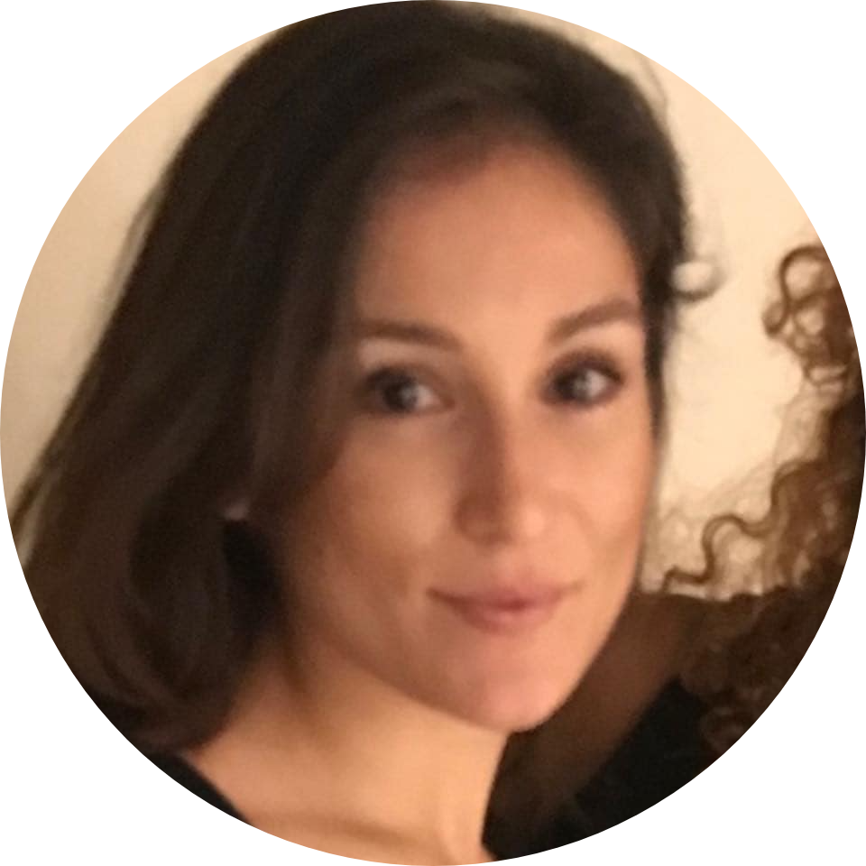
Our Team
Sean
Melinda
Vrinda
Grace
Ari

Slide 3
Roadmap
Problem and solution recap
Design changes
Testing
Findings and next steps

Slide 4

Problem and Solution Recap

Slide 5
Young adults need a trustworthy source of health insurance education

Slide 6
A health insurance forum, with hassle-free insurance detail extraction and optimal organization of feedback from peers

Slide 7
Design Changes

Slide 8
Heuristic evaluation summary
Provide more transparency on where personal health information is coming from and how it will be used
Give more explicit guidance on the question-asking process
Explain where the comment clusters came from and allow more flexibility for determining how comments are clustered

Slide 9
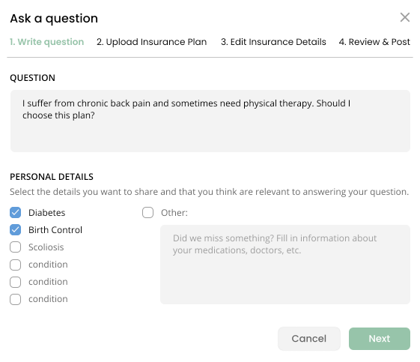
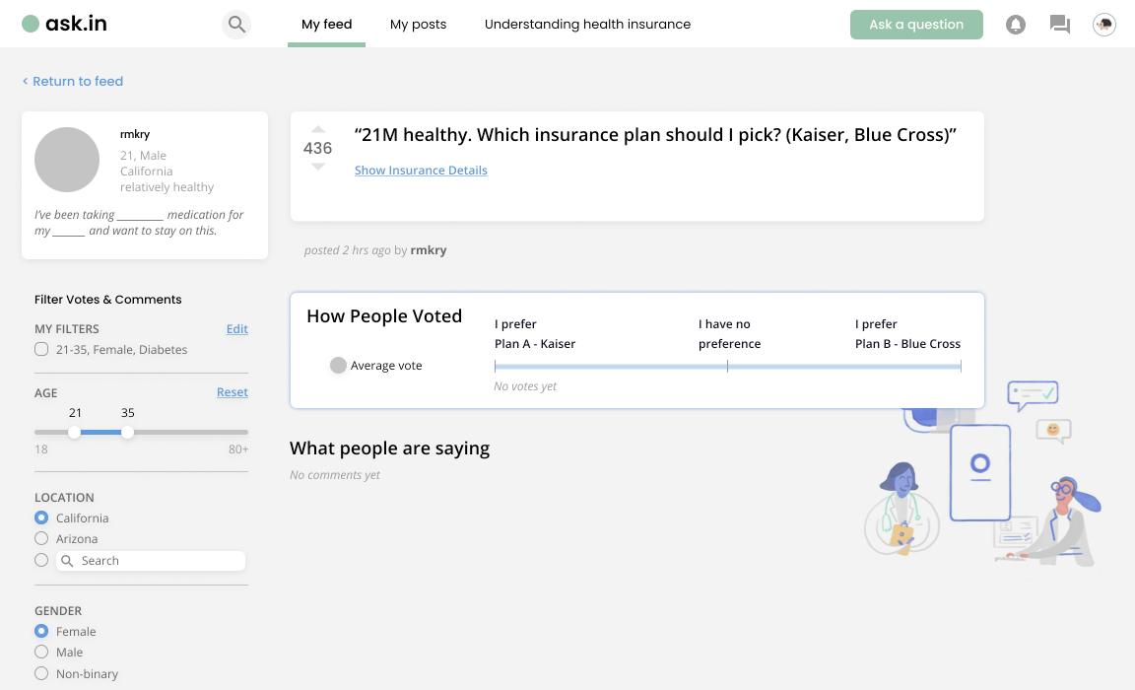
Old design - inconsistent user profile
Notes:
profile making flow (privacy notes) and AI application (melinda/sean)
name, email, details, what’s your experience with health insurance?, here’s a list of fields that makes sense for you to share when you’re writing q’s

Slide 10
Redesign 1 - transparency of personal info
Demo time!
Notes:
profile making flow (privacy notes) and AI application (melinda/sean)
name, email, details, what’s your experience with health insurance?, here’s a list of fields that makes sense for you to share when you’re writing q’s

Slide 11
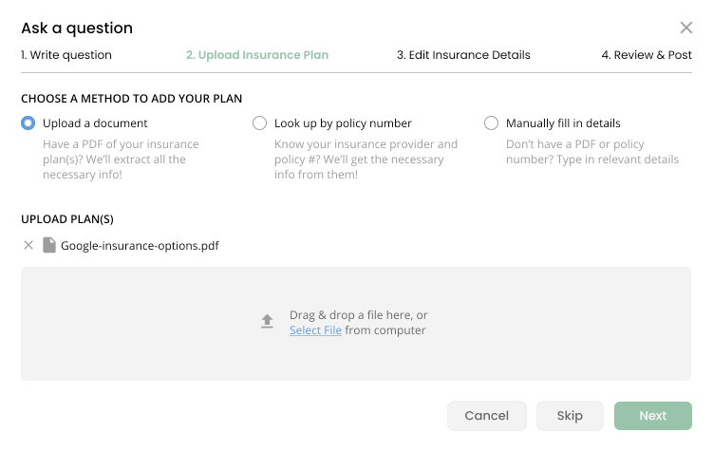
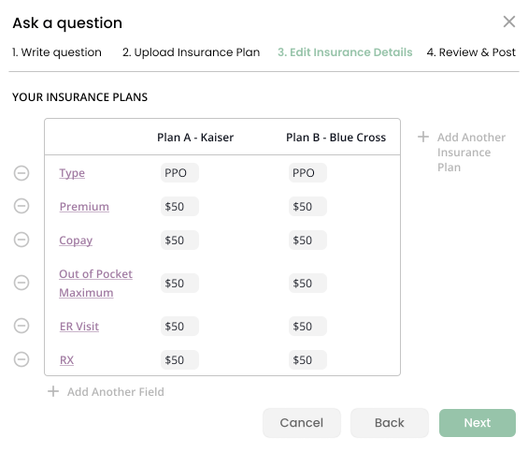
Old design - asking a question
Notes:
Where did these come from?

Slide 12
Redesign 2 - more support with asking a question
Demo time!

Slide 13
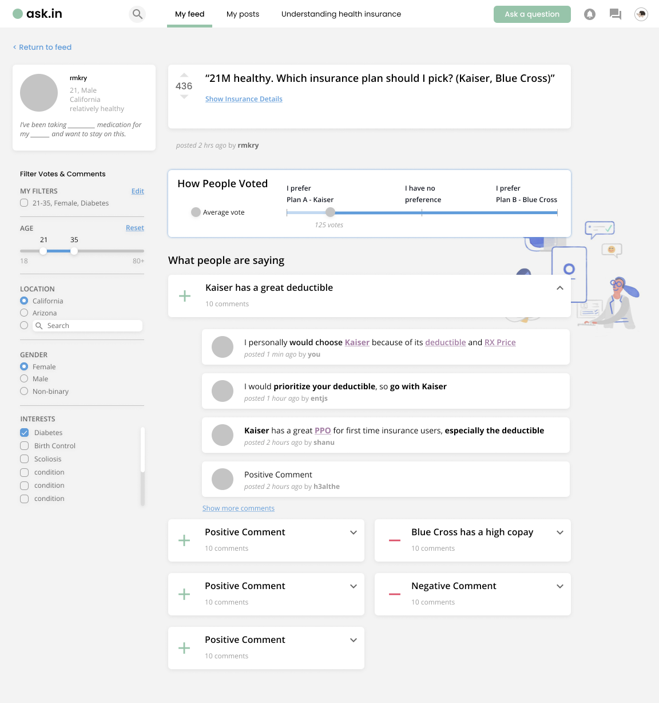
Old design - comment grouping
Notes:
-tooltip explaining ai comment grouping (vrinda)
- instead of L/R, mix it all up and do sort by “popularity”, “+/-” (melinda)

Slide 14
Redesign 3 - more flexible comment grouping
Demo time!
Notes:
-tooltip explaining ai comment grouping (vrinda)
- instead of L/R, mix it all up and do sort by “popularity”, “+/-” (melinda)

Slide 15
Testing

Slide 16
Study goals
Test the new profile creation flow
Provide less strict tasks and see how the users interact with the prototype
Understand preferences for comment grouping
Notes:
Talk about methods!!!

Slide 17
Study participants
Insurance Types
Reddit-style Forum Usage
Technology Usage
Employment Status
Healthcare knowledge
Industry
5 interviewees

Slide 18
Findings and next steps

Slide 19
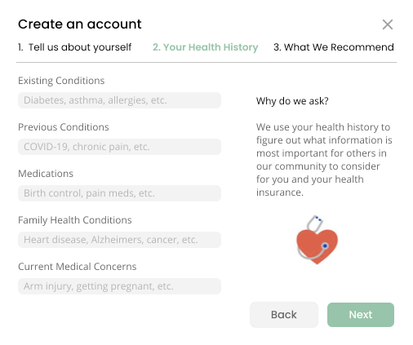
Finding
Users are concerned about sharing private health condition information

Slide 20
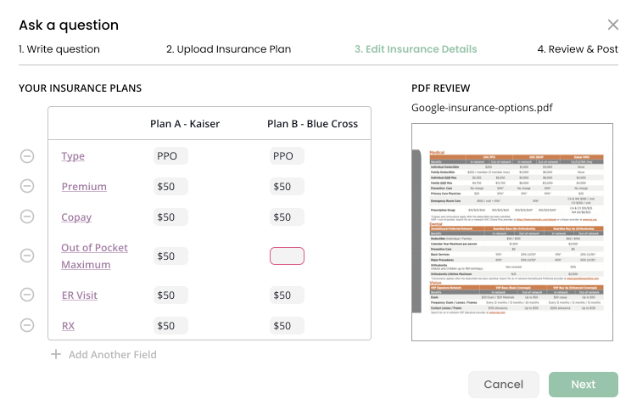
Finding
Users are concerned about sharing private health condition information

Slide 21
Finding
Design changes
Users are concerned about sharing private health condition information
Include a strong privacy guarantee in account creation
Make including a PDF in question optional

Slide 22
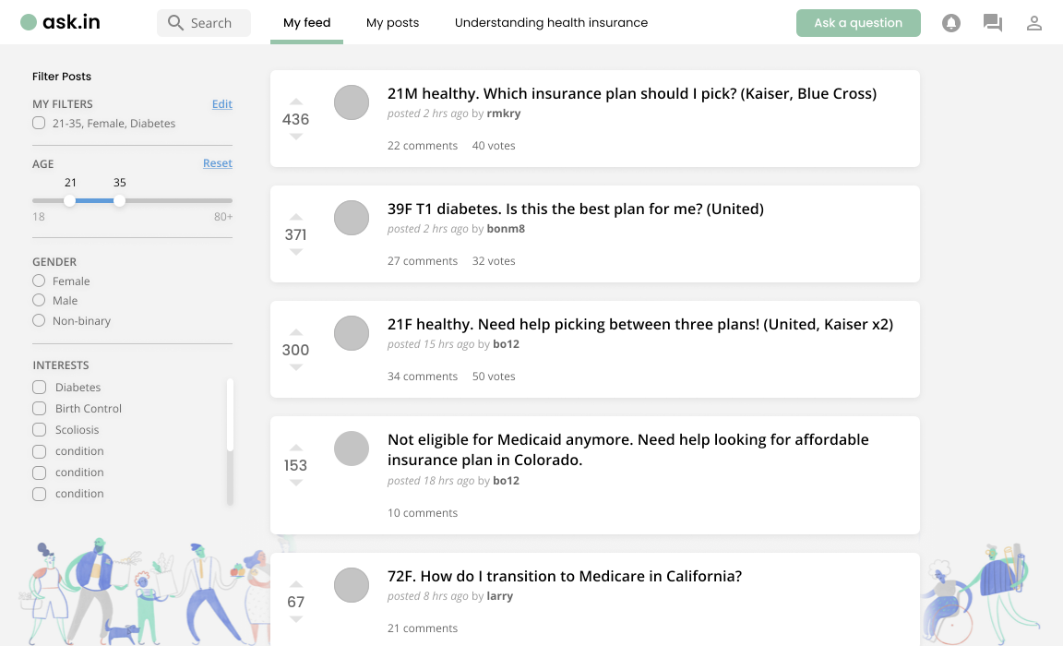
Finding
Users did not notice the option to upvote / downvote posts

Slide 23
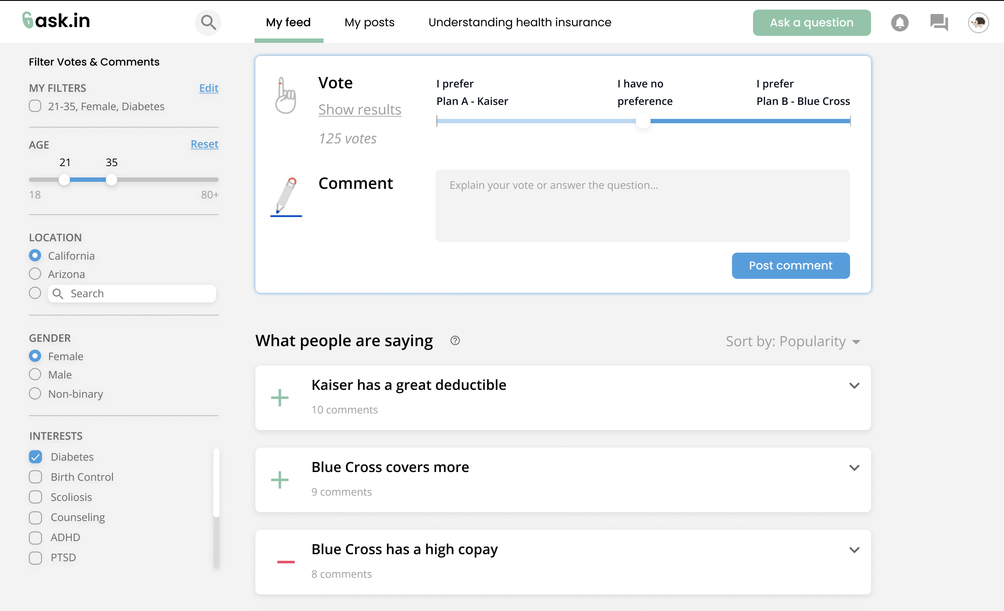
Finding
Users did not notice the option to upvote / downvote posts

Slide 24
Finding
Design changes
Users did not notice the option to upvote / downvote posts
Clarify the difference between upvoting a post and actually voting on insurance plans

Slide 25
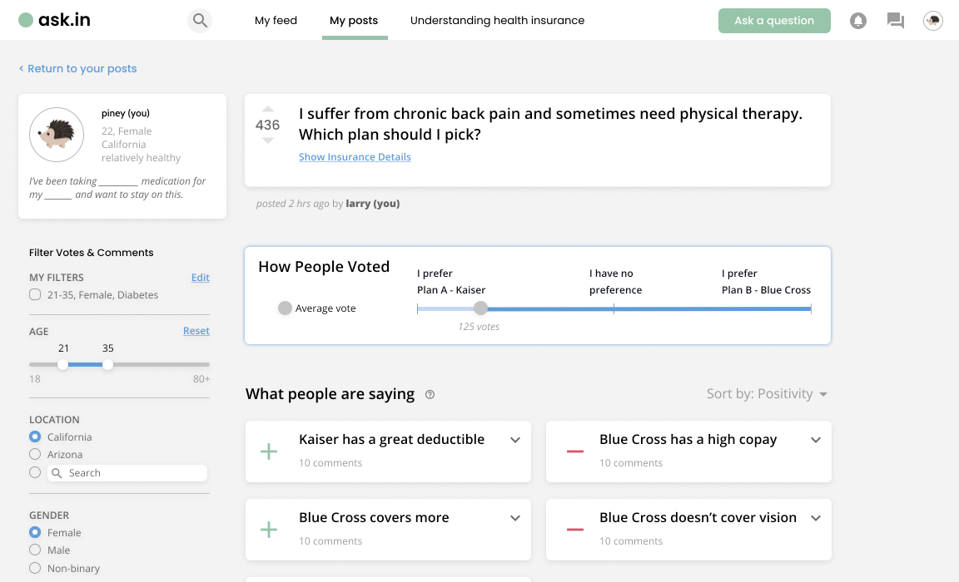
Finding
Users did not realize that they can filter votes and comments to be people they trust on their own posts

Slide 26
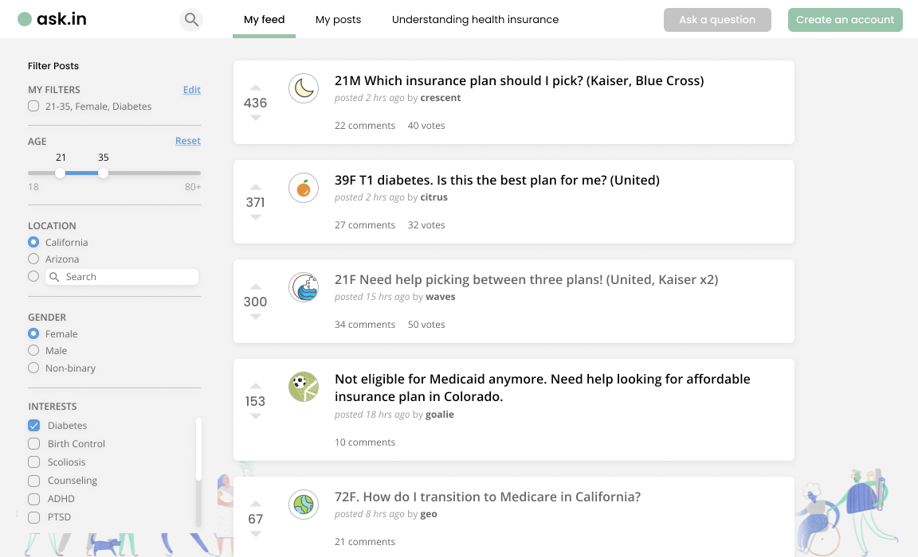
Finding
Users did not realize that they can filter votes and comments to be people they trust on their own posts

Slide 27
Finding
Design changes
Users did not realize that they can filter votes and comments to be people they trust on their own posts
Highlight and differentiate the functionality of filtering votes and comments on one’s posts

Slide 28

Thank you!
Any Questions?

Slide 29
Appendix

Slide 30
Prototype Links
Heuristic Evaluation Changes: https://www.figma.com/file/DSgazxvGULbbsE81VnX8qs/377E-Health-Insurance-Education?node-id=535%3A5567
Redesign: https://www.figma.com/file/DSgazxvGULbbsE81VnX8qs/377E-Health-Insurance-Education?node-id=796%3A384

